Slide 1

Hotel System Network Design

Slide 2
Introduction
Project Idea
Methodology and Tools
Hotel System Network Design
System Design
Implementation

Slide 3
Introduction
A strong network is essential for hotels.
It allows easy access to online resources,
supports communication and teamwork,
simplifies administrative tasks,
aids in research,
and keeps information secure.
Modern hotel networks need:
- High speed and capacity for lots of data and users
- Reliability with backup systems to ensure constant availability
- Strong security to protect against cyber threats
- Scalability to grow with the university's needs
- Strong Wi-Fi coverage across campus
- Easy integration with cloud services
- Advanced tools for management and optimization.

Slide 4
Project Idea
Problem Statement
Issues with Existing Hotel Networks
Frequent connectivity disruptions.
Insufficient wireless coverage.
Vulnerabilities in network security.
Lack of scalability to accommodate future growth.
Need for a Robust, Secure, and Scalable Network Solution
Ensure continuous, high-speed internet access.
Provide extensive and reliable wireless connectivity.
Implement strong security measures to protect data.
Design for scalability to support increasing demands.

Slide 5
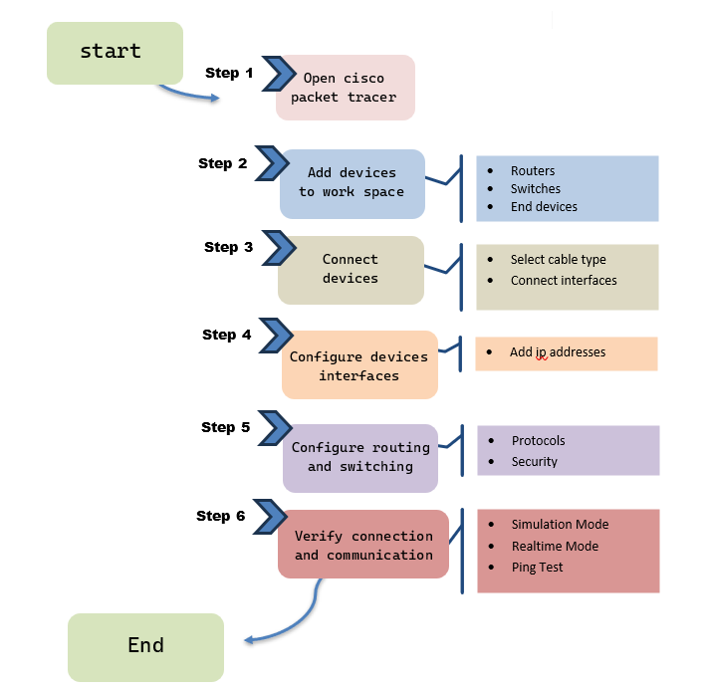
Methodology and Tools
Project Methodology
Tools Used
Cisco Packet Tracer

Slide 6
System Design
Key Improvements in our network design
Enhanced Reliability:
More robust and stable network infrastructure to minimize disruptions.
Improved Wireless Coverage:
Comprehensive Wi-Fi coverage across the campus.
Increased Bandwidth:
Higher bandwidth to support high-speed internet and large data transfers.
Advanced Security Measures:
Stronger security protocols to protect against cyber threats.
Scalability:
Designed to accommodate future growth and evolving technology needs.

Slide 7
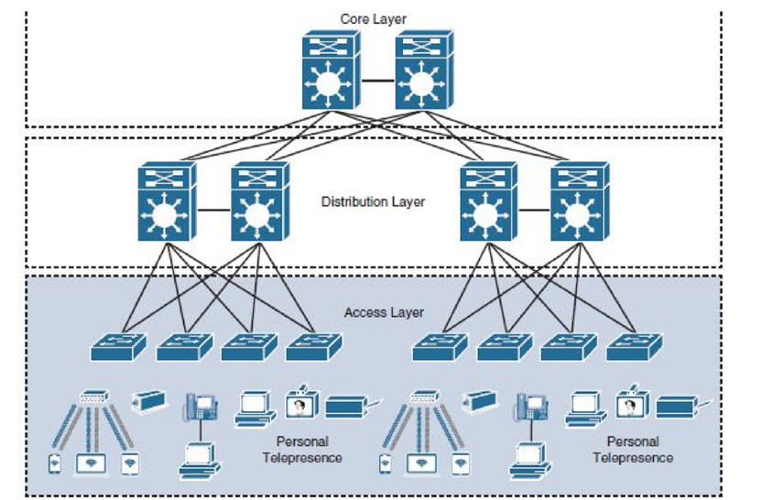
Hierarchical Network Model
System Design
Design
Access Layer
provides a connection for end-user . does not forward frames between two other access switches under normal conditions

Slide 8
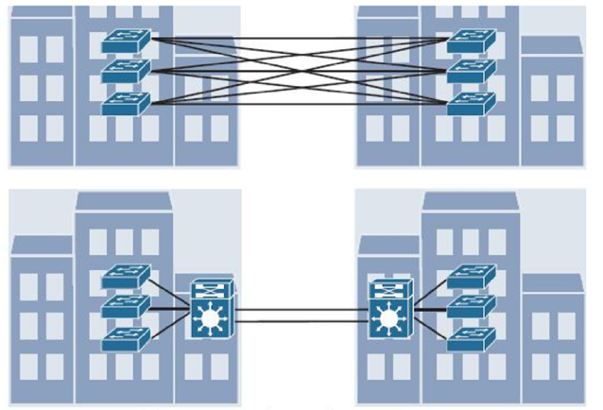
Hierarchical Network Model
System Design
Design
Distribution Layer
aggregation point for access switches, not connection directly to end-user

Slide 9
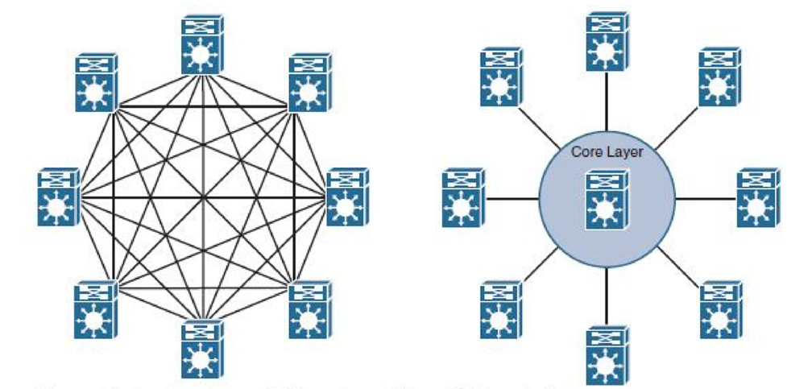
Hierarchical Network Model
System Design
Design
Core Layer
aggregates distribution switches in very large campus LANs, providing very high forwarding rates for the larger volume of traffic due to the size of the network

Slide 10
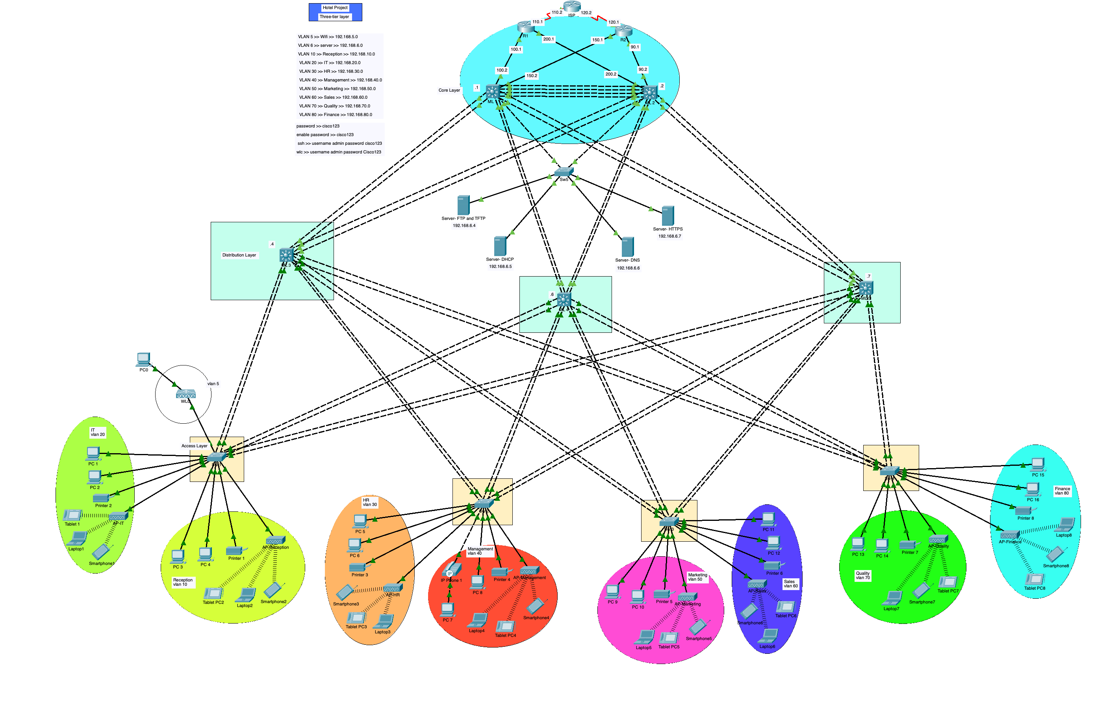
Network design

Slide 11
Implementation
Switching
Eslam Hany
Routing
Implementation Network Technologies and Protocols
Eslam Hany
Backup
DHCP
Wireless
Remote access
SERVERS
Mohamed Essam
Verena Ashraf
Subnetting
NAT
Security
Verena Ashraf

Slide 12
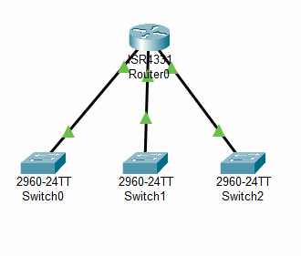
Switching
VlAN
To solve the problem of broadcast before VLAN
What is VLAN ,and why we made it?
It reduces the size broadcast of the network
It reduces the cost and improve performance
When I send a broadcast for making a ping , first thing the device resave and read is :
Destination mac address
Source mac address
Destination ip address
Source ip address
This design solve the problem of broadcast but
the router have limited ports
And its increase the cost because of the big number of switches

Slide 13
Switching
VlAN
Benefits of VLAN
I can create 4096 VLANs on one switch
Segmentation B.C domain
Different subnet
Quality of service
Easy access control
There is Two protocol to Trunk
ISL
It is not tagged because it takes the original Ethernet frame without the tag and adds a new encapsulation in a protocol called ISL. This was adding about 30 bytes, and this was wasting bandwidth and unnecessary link space.
DOT1Q
It places Tagged on each vlan and does not consume link space without benefit and does not affect Bandwidth

Slide 14
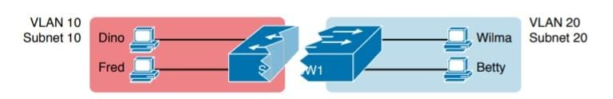
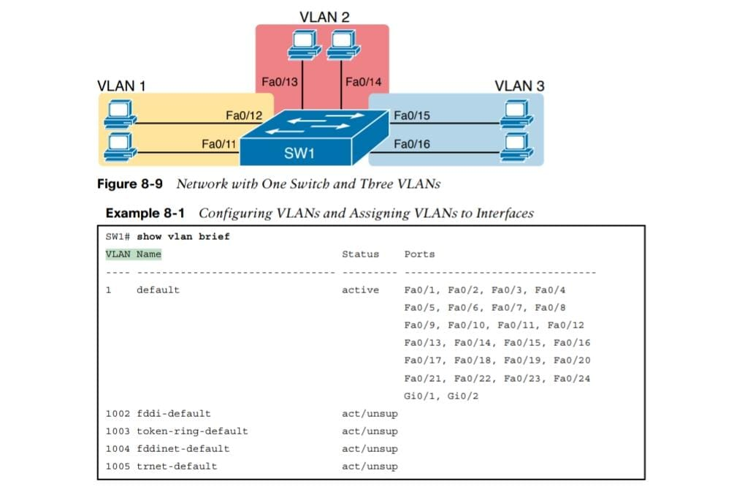
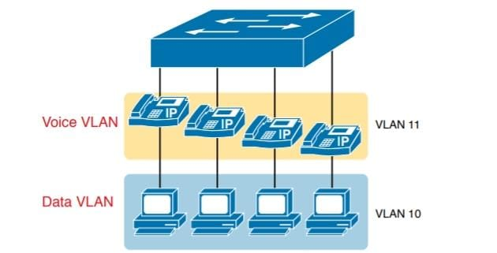
Switching
VlAN
Type of VLAN
Defult VLAN
Data VLAN
Native VLAN
Management VLAN
Voice VLAN
Vlan
Spanning tree
port fast
Bpdu guard
Ether channel

Slide 15
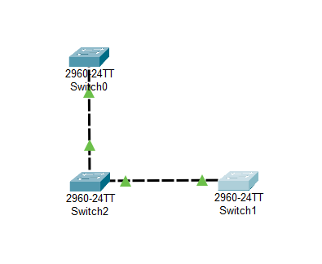
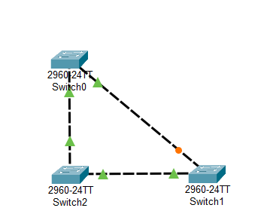
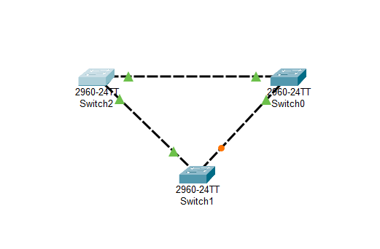
Switching
STP( spanning tree protocol )
redundancy
The solve of this problem is stp
Stp block
If the link cut there will not be anther path
If the link cut there will be anther path
To improve the availability It must be sure if the redundancy is exist
Problems of redundancy
Broadcast storm
Loop
Multi frame transition

Slide 16
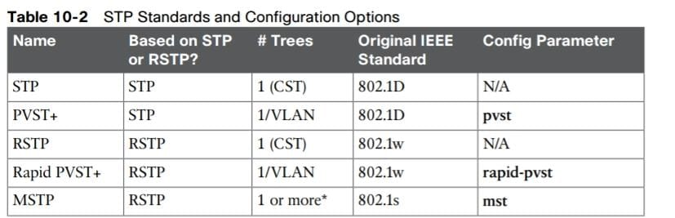
Switching
STP( spanning tree protocol )
Vlan 1 STP topology
Vlan 2 STP topology
root
root
X
X

Slide 17
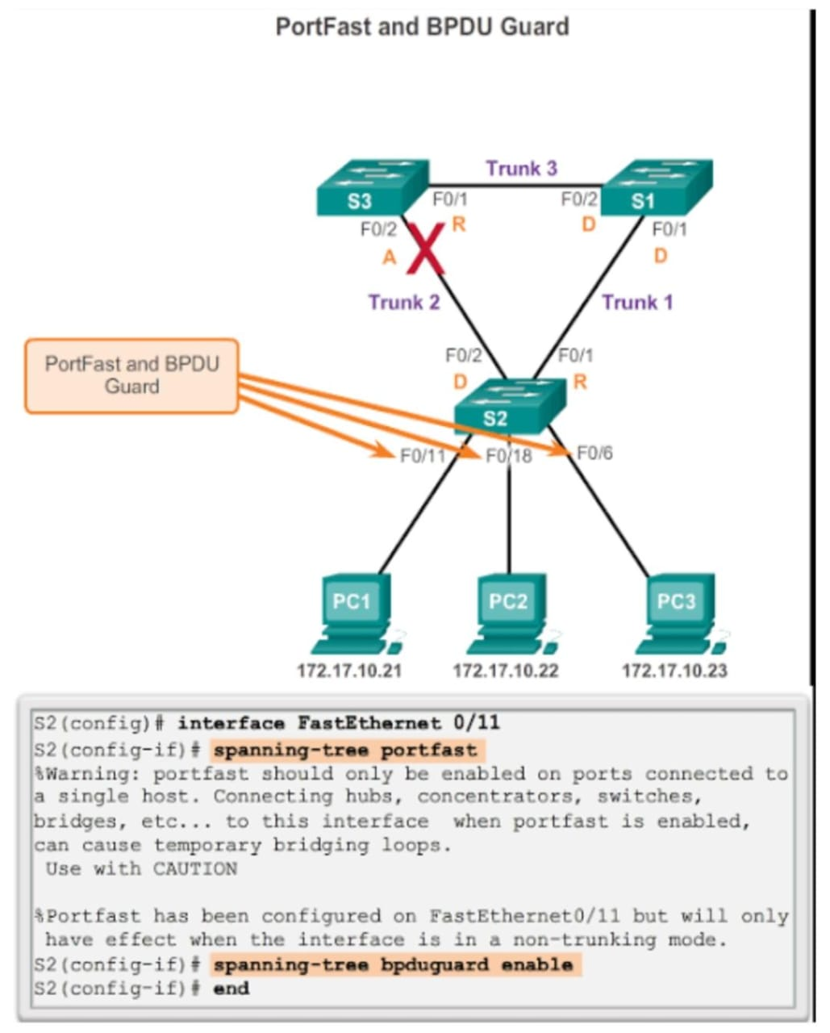
Routing
Port fast & BPDU guard
Switching
Port fast
The port fast is the port that connect directly with the pc
When make port fart there will be to steps
Learning listening
I have to make sure that the port not connect with the SW or HUB must be connect in pc
BPDU guard
We put it in the port that we know will not receive the Bpdu message, which is Access port, but when it receives Bpdu, the port becomes shutdown.

Slide 18
Switching
Types of EtherChannel:
Static (Manual) EtherChannel:
Description: Links are manually configured to form a channel without using any negotiation protocols.
Use Case: Suitable for simple networks where dynamic negotiation is not necessary, requiring consistent configuration on both ends of the channel.
Link Aggregation Control Protocol (LACP):
Description: An IEEE 802.3ad standard protocol used for dynamically negotiating and managing EtherChannel links. LACP ensures compatibility and correct configuration between devices from different vendors.
Use Case: Ideal for multi-vendor environments where interoperability is essential. LACP provides flexibility and ease of management in dynamic network topologies.
Port Aggregation Protocol (PAgP):
Description: A Cisco proprietary protocol that automatically negotiates the formation of an EtherChannel. PAgP ensures that both ends of the channel are correctly configured and compatible.
Use Case: Best for networks predominantly using Cisco devices, simplifying configuration and maintenance with automatic negotiation

Slide 19
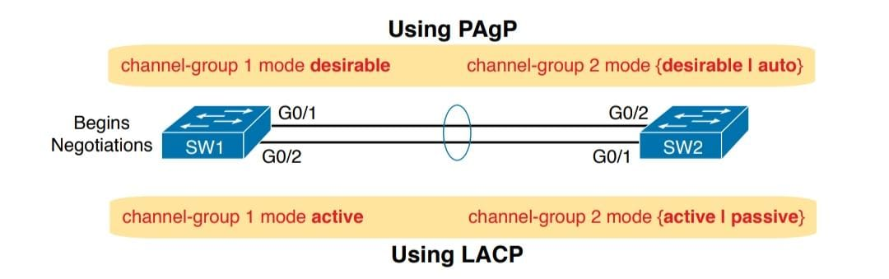
Switching
EtherChannel Modes:
LACP Modes:
Passive: The interface responds to LACP packets but does not initiate them. It forms an EtherChannel if it receives LACP packets from the other side.
Active: The interface actively initiates LACP negotiation to form an EtherChannel.
Static (Manual) EtherChannel:
On Mode: EtherChannel is formed unconditionally without any negotiation. Both ends must be set to “on” mode.
Off Mode: Disables EtherChannel, leaving interfaces as standalone links without aggregation or negotiation
PAgP Modes:
Auto: The interface responds to PAgP packets but does not initiate them. It forms an EtherChannel if it receives PAgP packets from the other side.
Desirable: The interface actively initiates PAgP negotiation to form an EtherChannel.

Slide 20
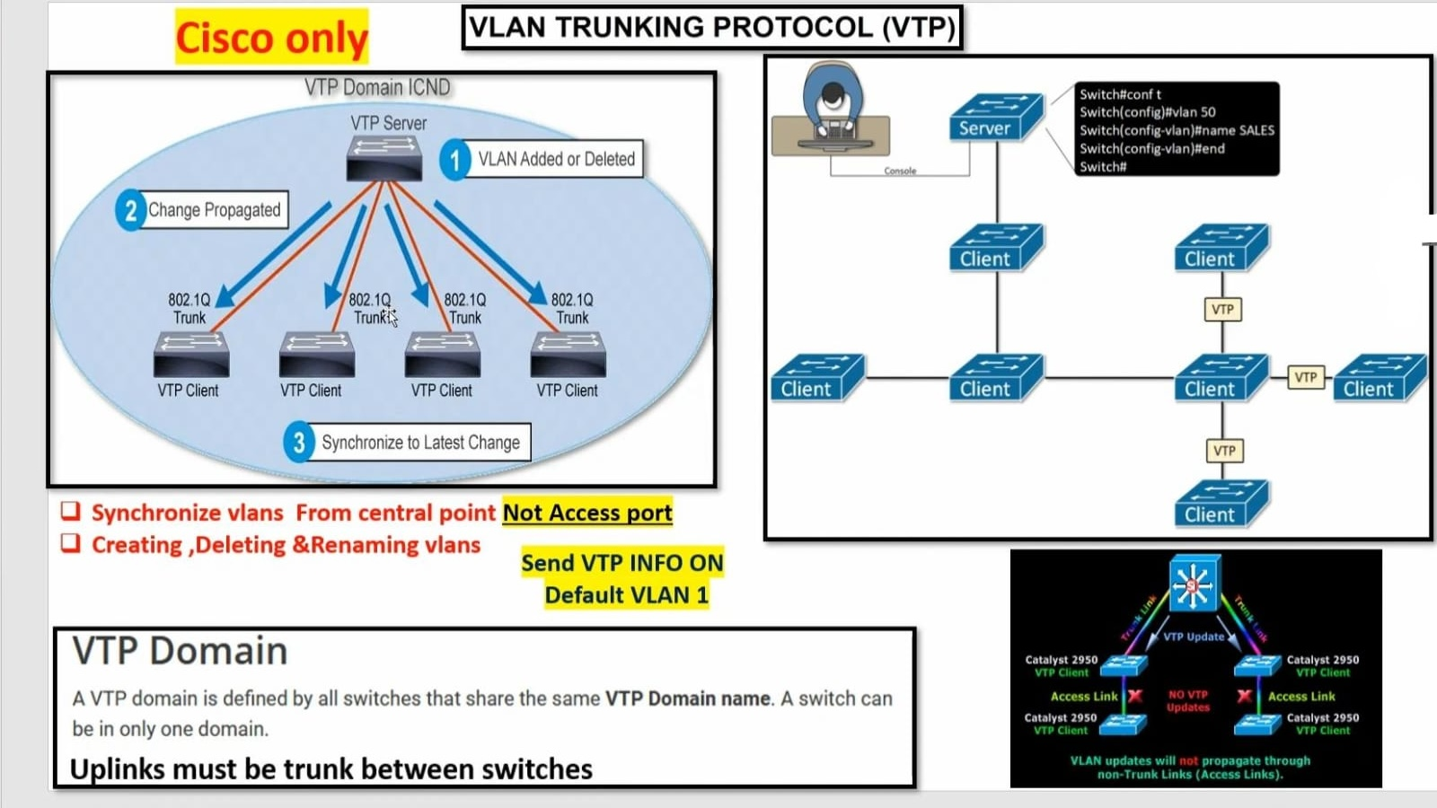
Switching

Slide 21
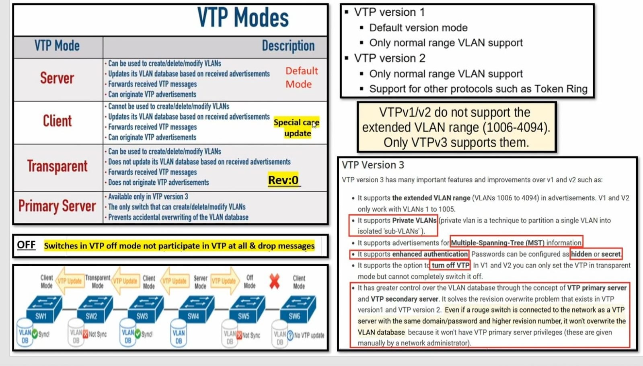
Switching

Slide 22
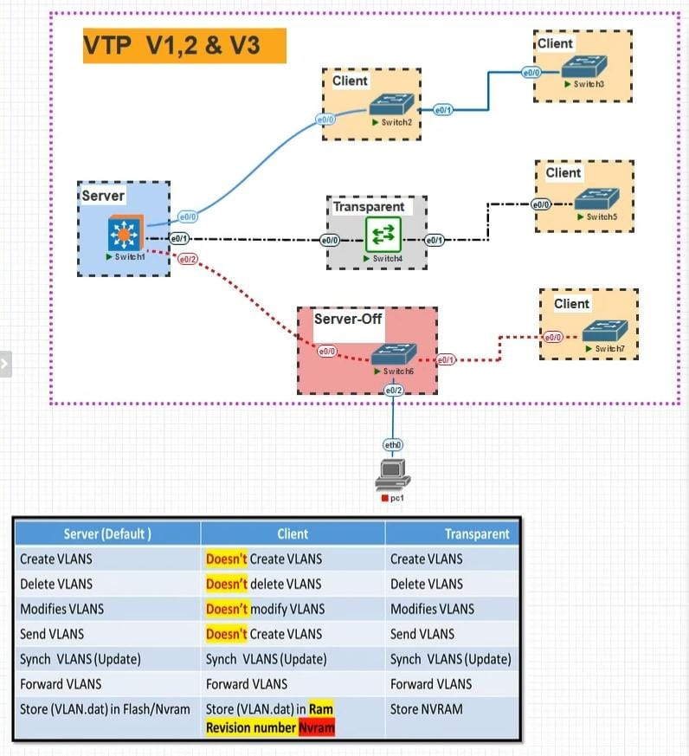
Switching

Slide 23
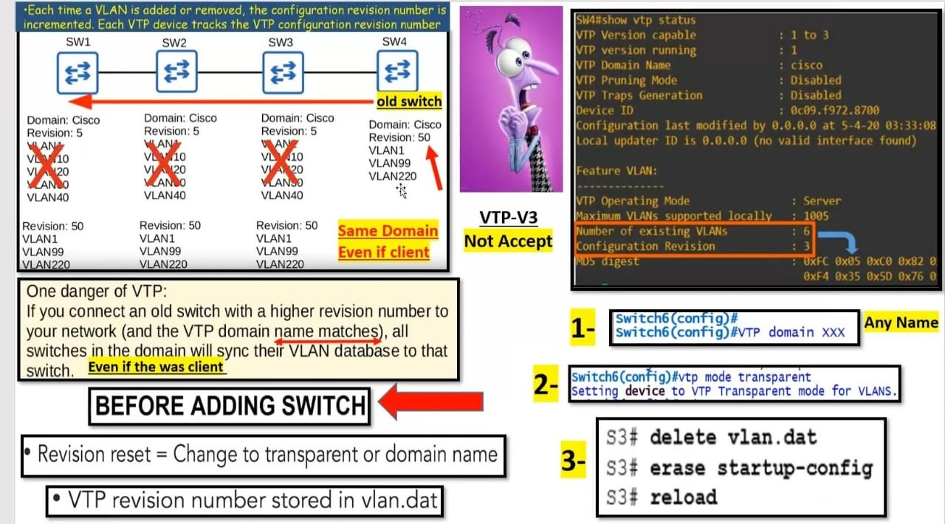
Switching

Slide 24
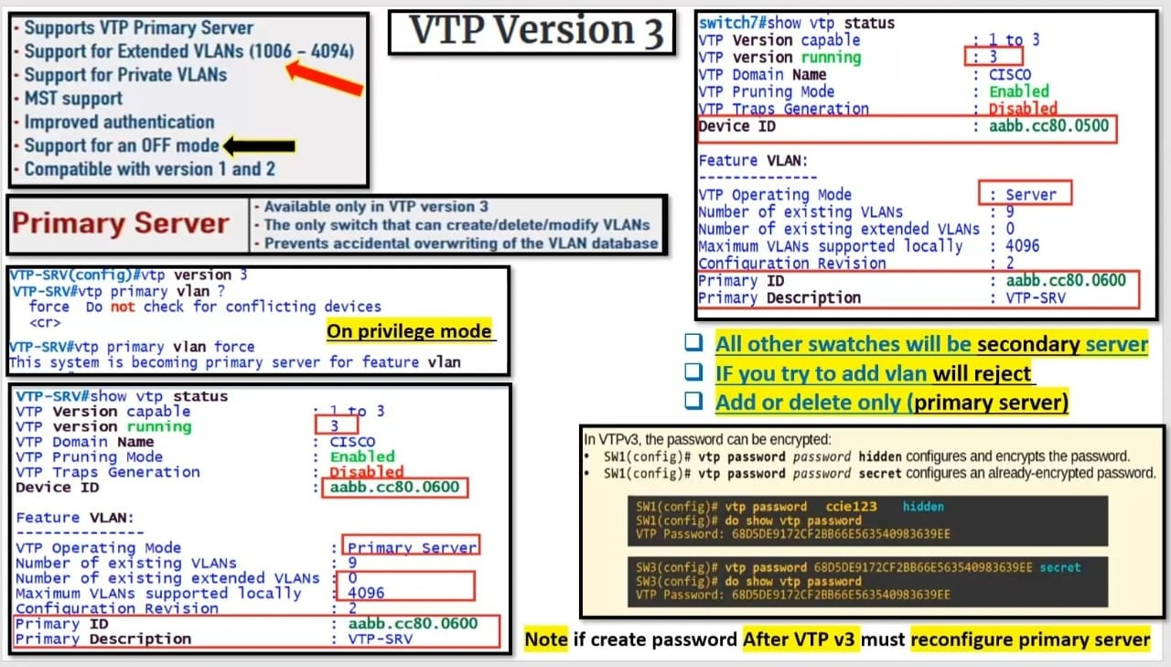
Switching

Slide 25
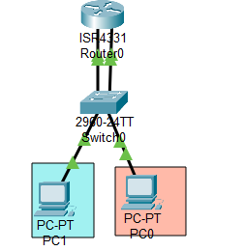
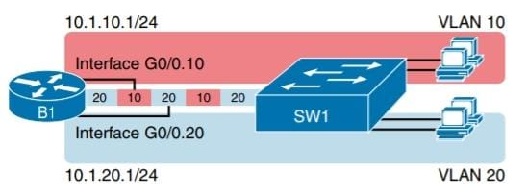
Routing
Inter VLAN
Traditional Inter VLAN Routing
using L3 Switch Routed interface
INTER VLAN Routing using L3 Switch SVIInter VLAN Routing.
using L3 Switch Routed interface

Slide 26
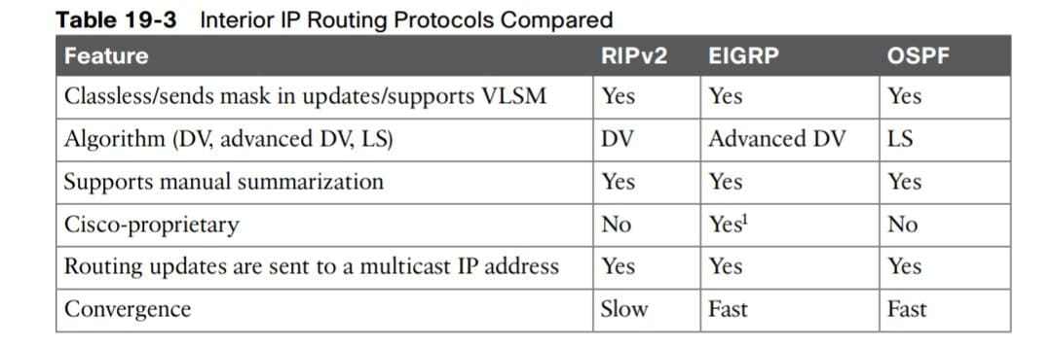
Routing
Routing protocols
Distance vector link state typrid
RIP-IGRP-BGP OSPF-IsIs EIGRP
Hop count speed-cost speed+delay+reliability+
load+bandwidth

Slide 27
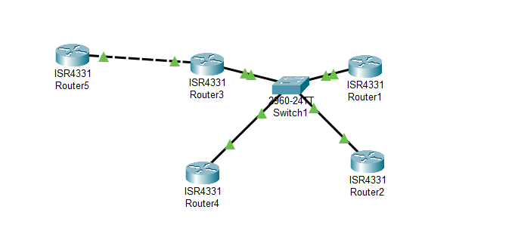
Routing
Ospf network type
Broadcast
Enable ethernet interface
Num. of router( num of router -1)/2
100(100-1)/2 = 4950 adjacency
BDR
DRother
DR
DR
The num of 4950 is a pig number it Couse ospf traffic
to solve the ospf traffic I chose the ((BDR)) and ((DR))
DR
DRother
DR/BDR election
Higher ospf interface priority
High Rid
High loopback
High active physical interface

Slide 28
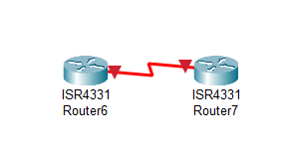
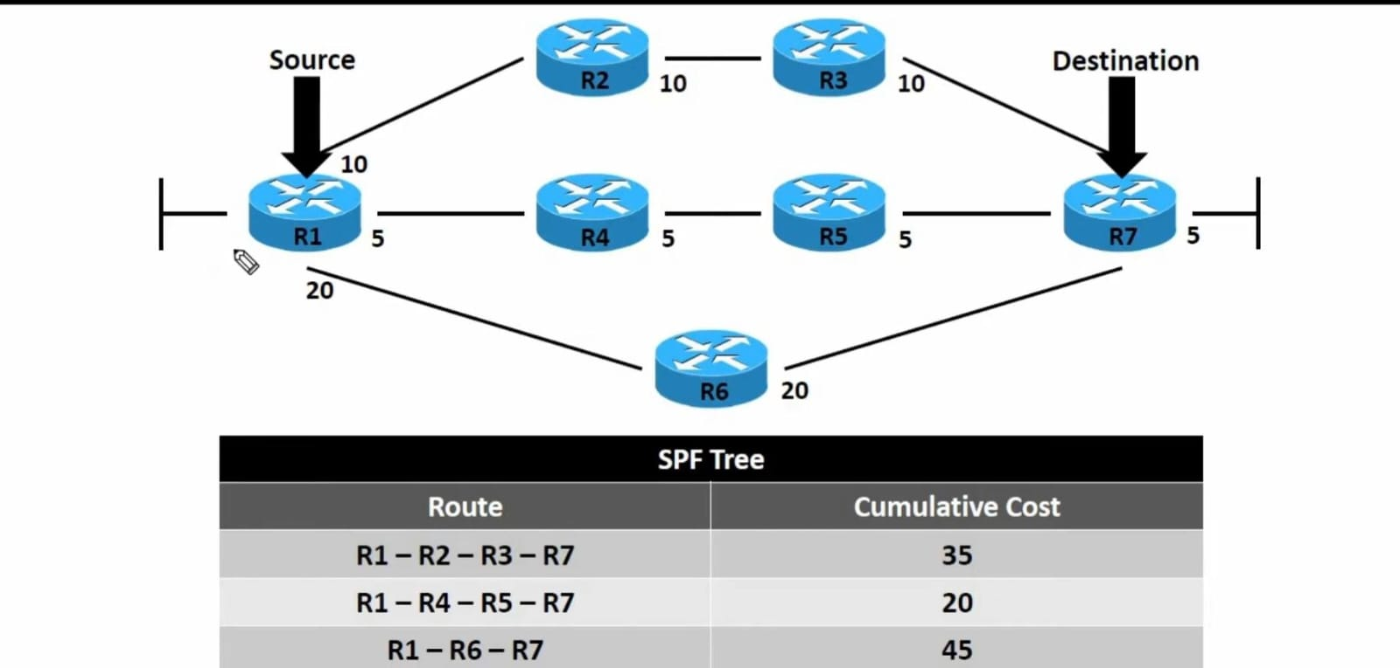
Routing
Ospf network type
2. Ospf point-to point
Ospf calculation
How ospf algorithm works:-
Ospf metric is called (cost)
No election DR and BDR
3. Passive interface

Slide 29
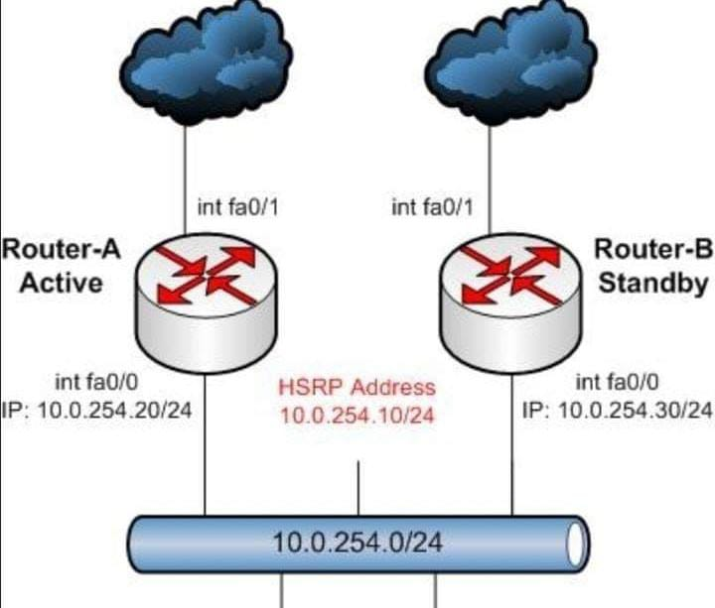
How HSRP Works:
Backup
How it Works:
Initial Setup: Routers in an HSRP group are configured with the same virtual IP address and different priority values.
Election Process: Routers exchange hello packets to elect an active router. The router with the highest priority becomes the active router.
Failover: If the active router fails, the standby router with the next highest priority takes over, ensuring uninterrupted network access.
Preemption: If a higher-priority router becomes available, it can preempt the current active router and take over its role.

Slide 30
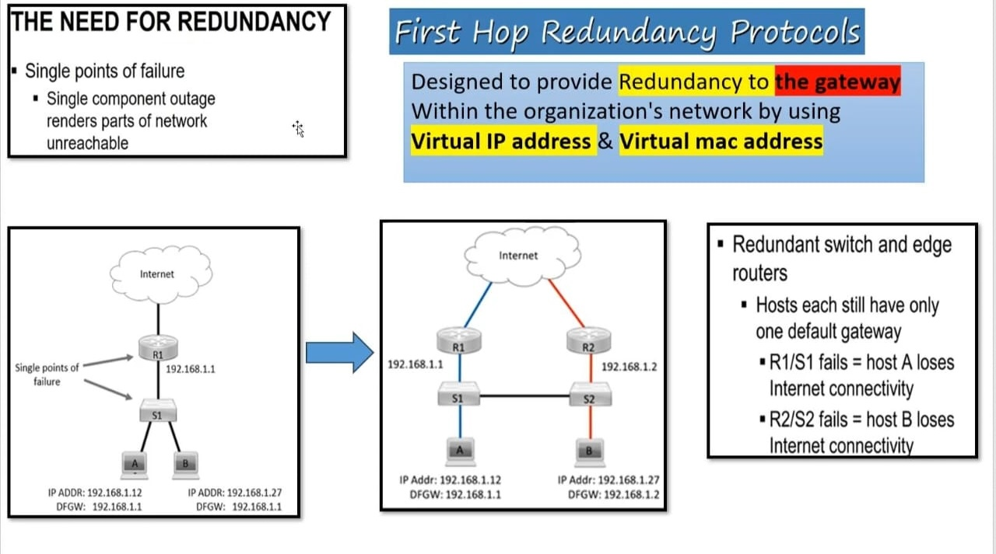
Backup

Slide 31
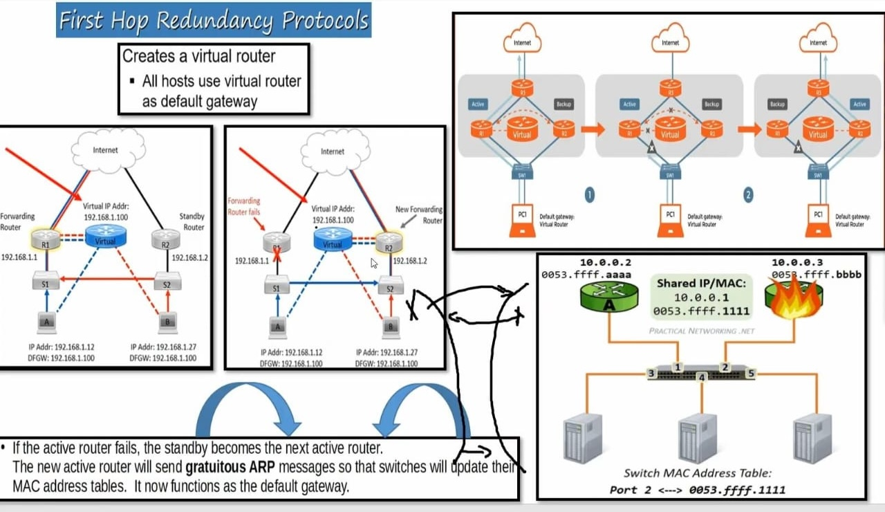
Backup

Slide 32
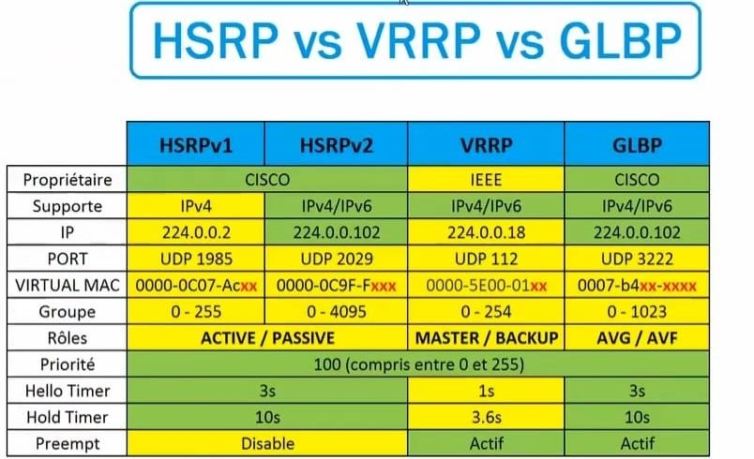
Backup

Slide 33
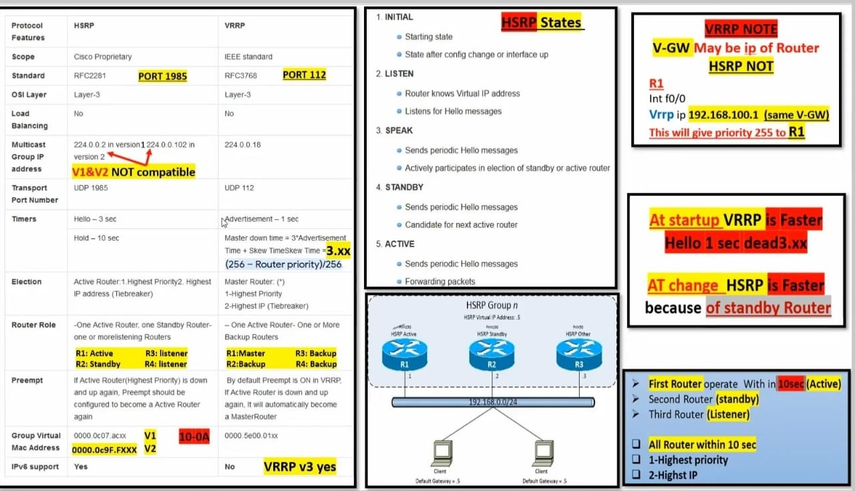
Backup

Slide 34
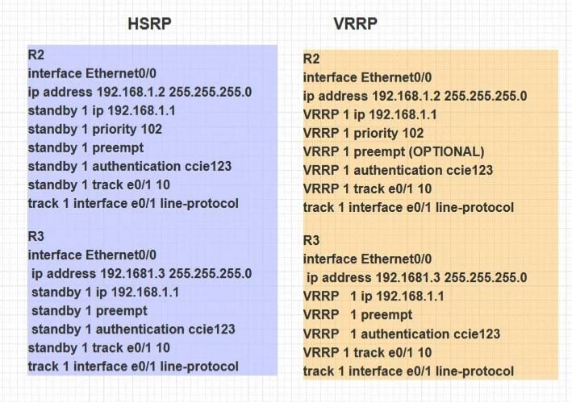
Backup

Slide 35
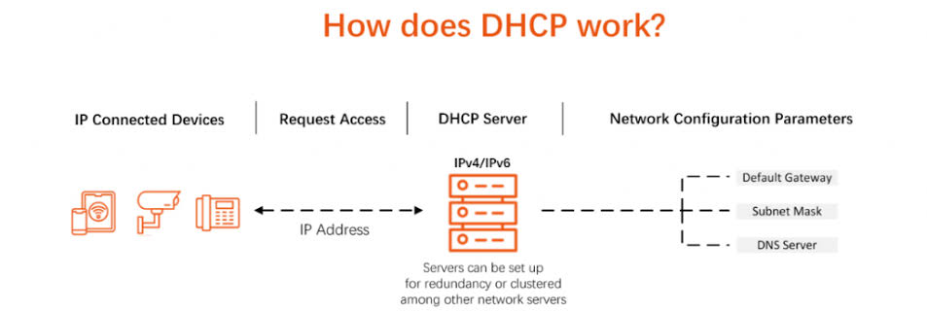
DHCP
Definition and use
Benefits
Disadvantages
Use it in the project
Problems

Slide 36
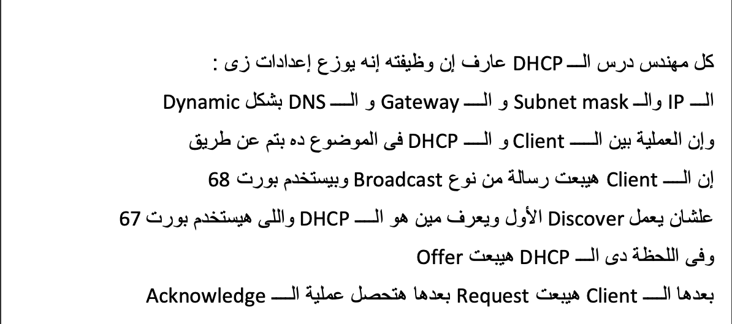
DHCP

Slide 37
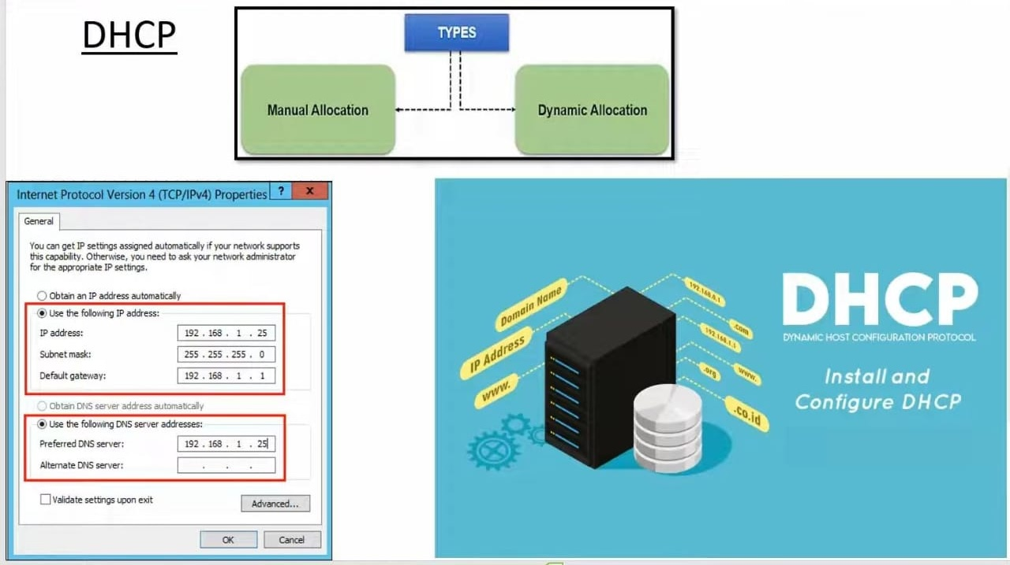
DHCP

Slide 38
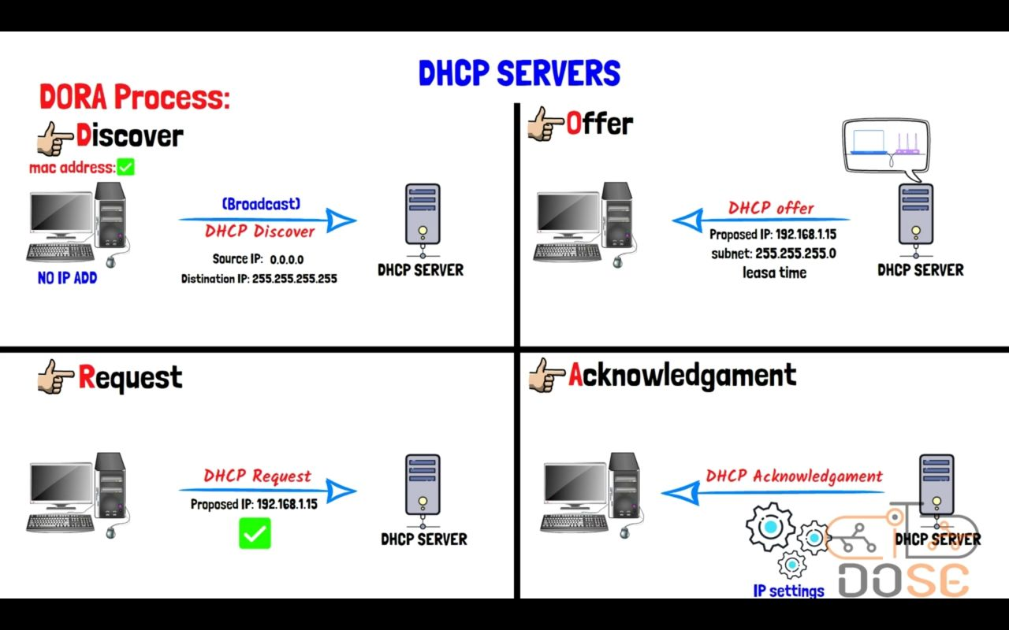
DHCP

Slide 39
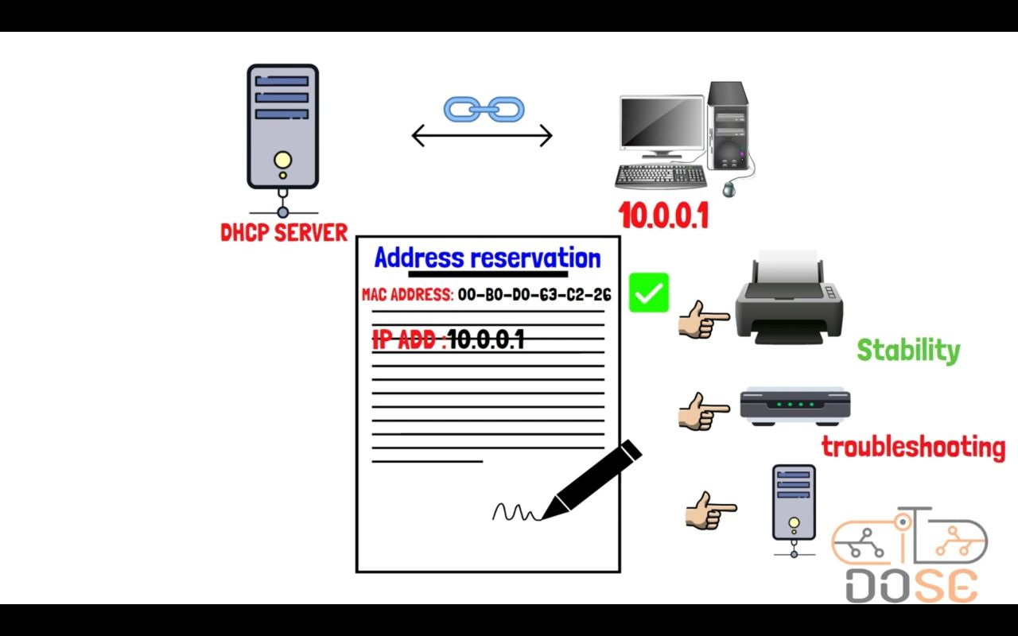
DHCP

Slide 40
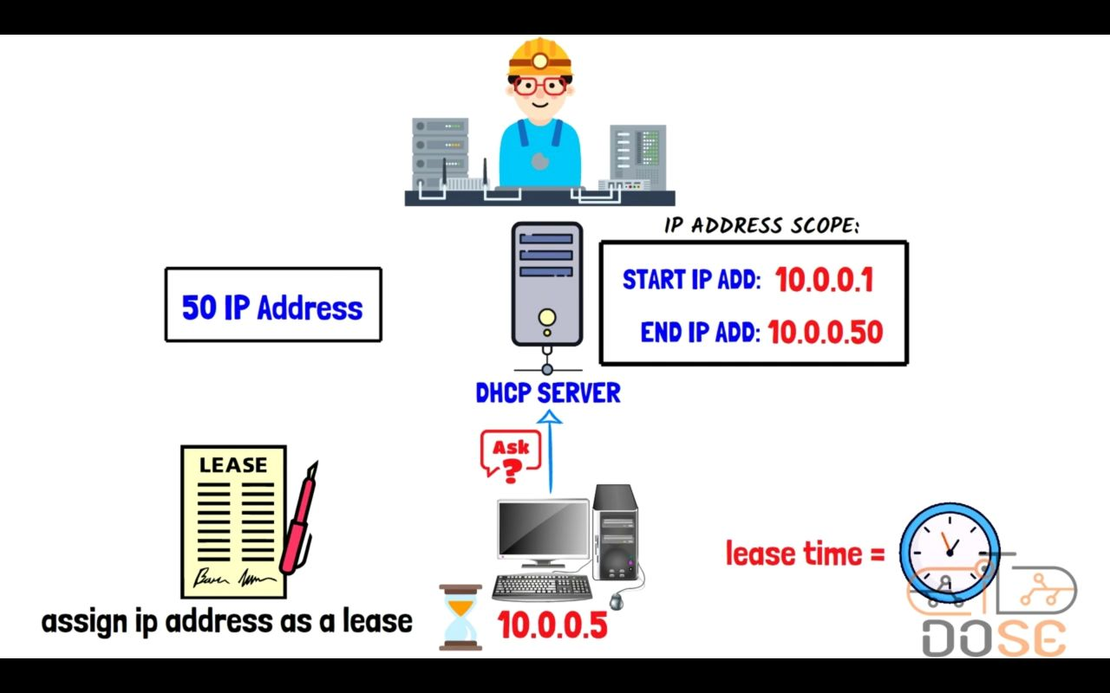
DHCP

Slide 41
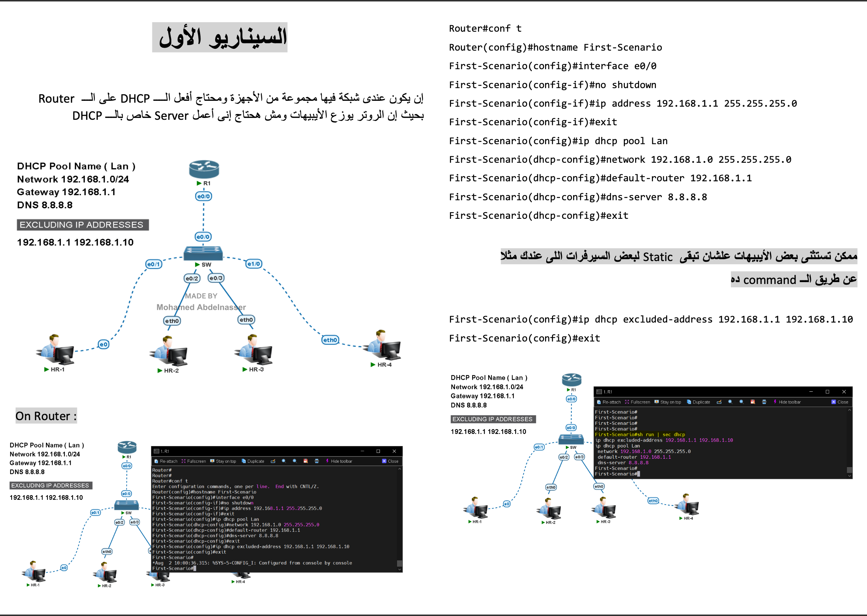
DHCP

Slide 42
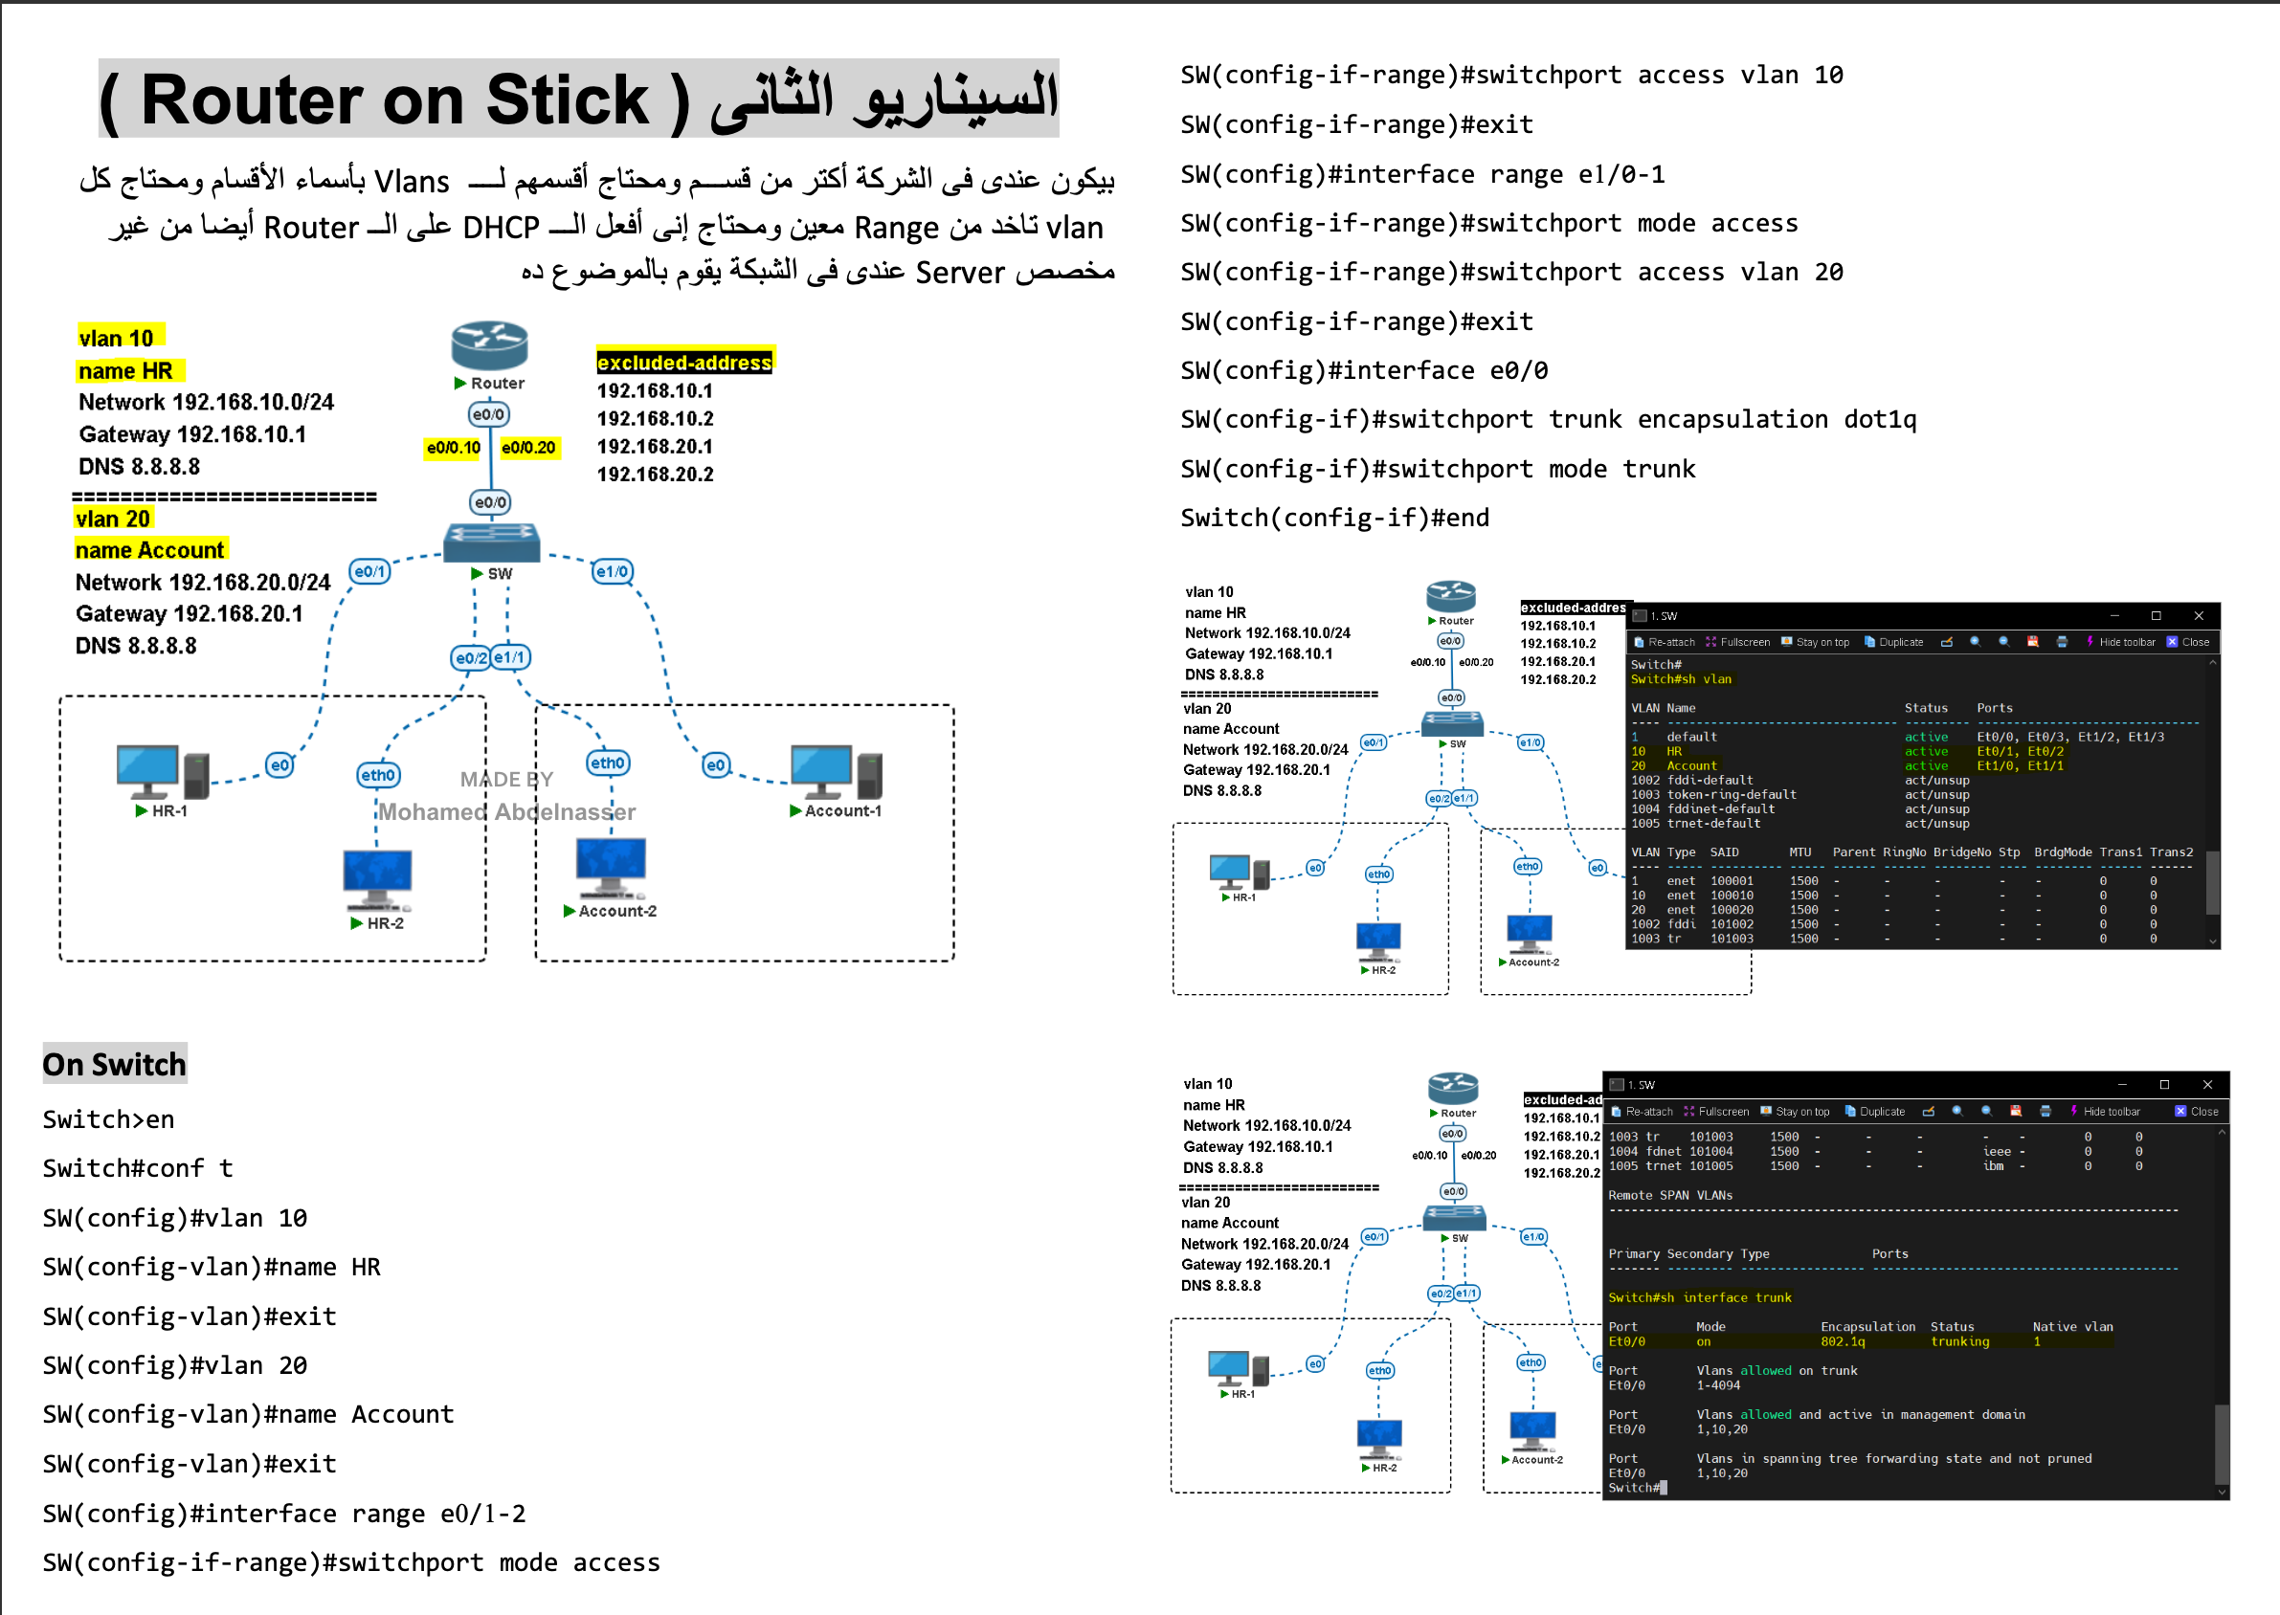
DHCP

Slide 43
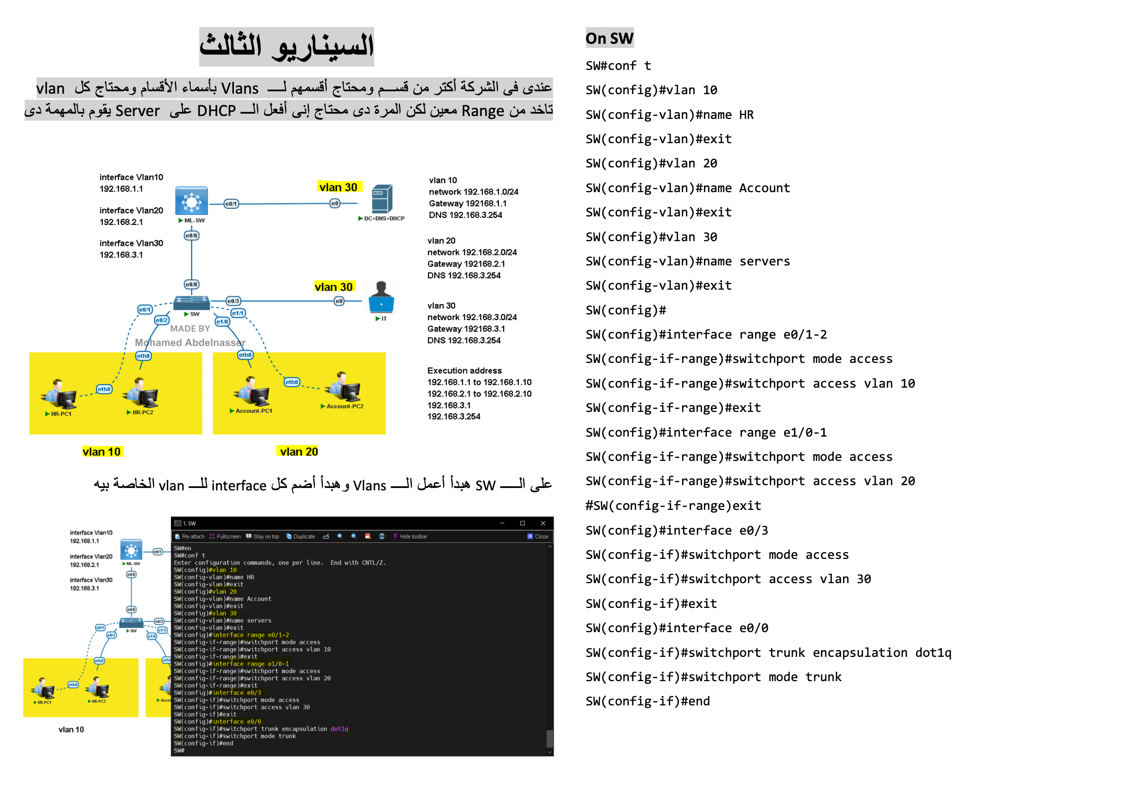
DHCP

Slide 44
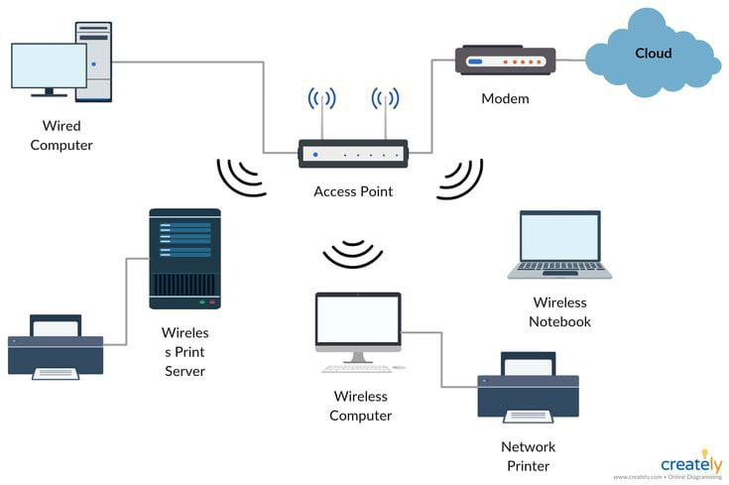
Wireless
Definition
The technology on which most wireless LANs are built today
Benefits
Streamline communication between users from anywhere
Use it in the project
To expand the network coverage of each role.
Problems
Weak network.

Slide 45
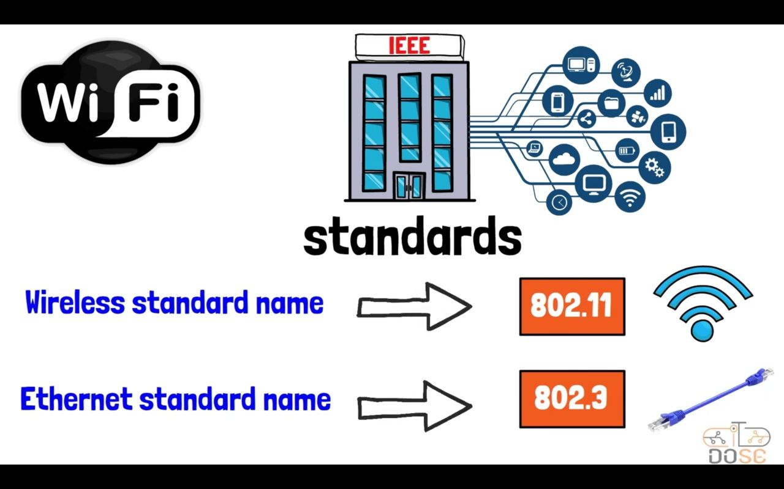
Wireless

Slide 46
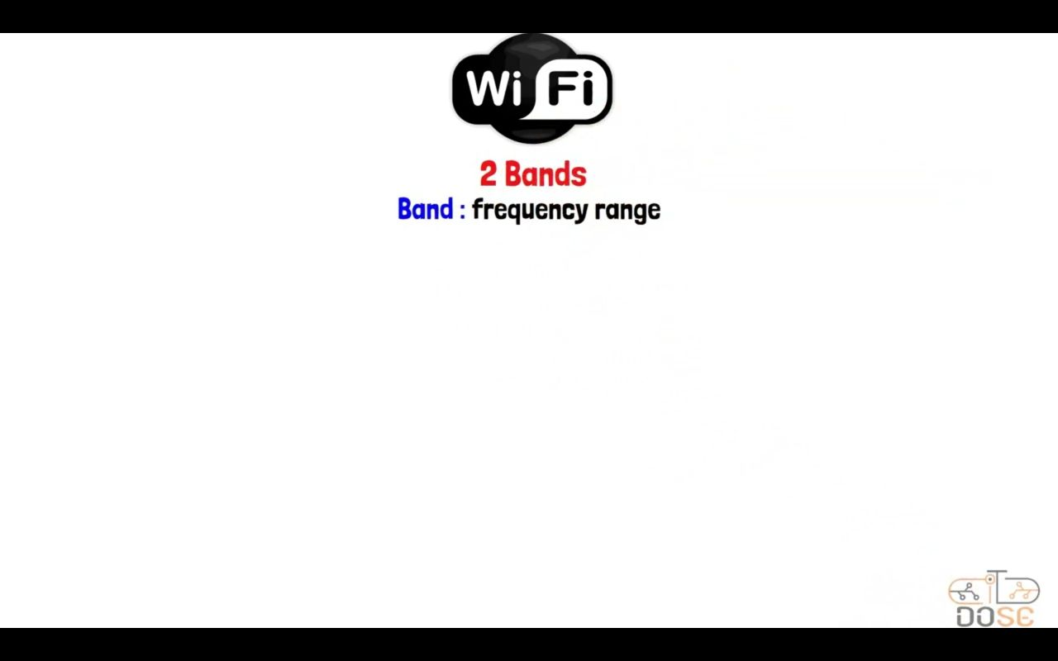
Wireless

Slide 47
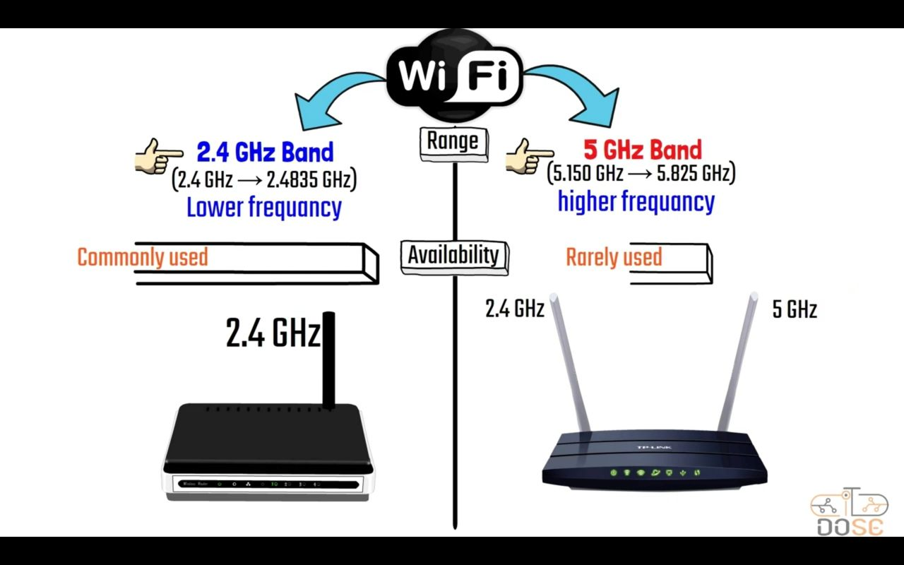
Wireless

Slide 48
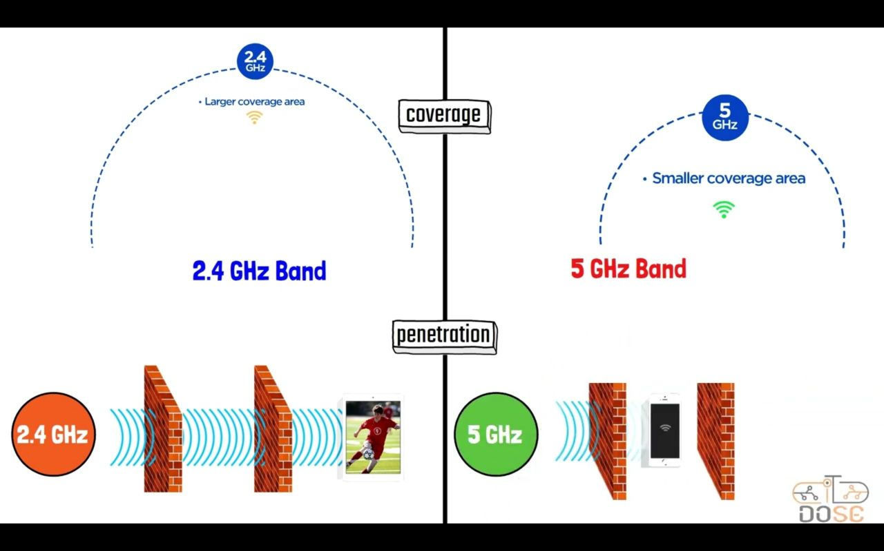
Wireless

Slide 49
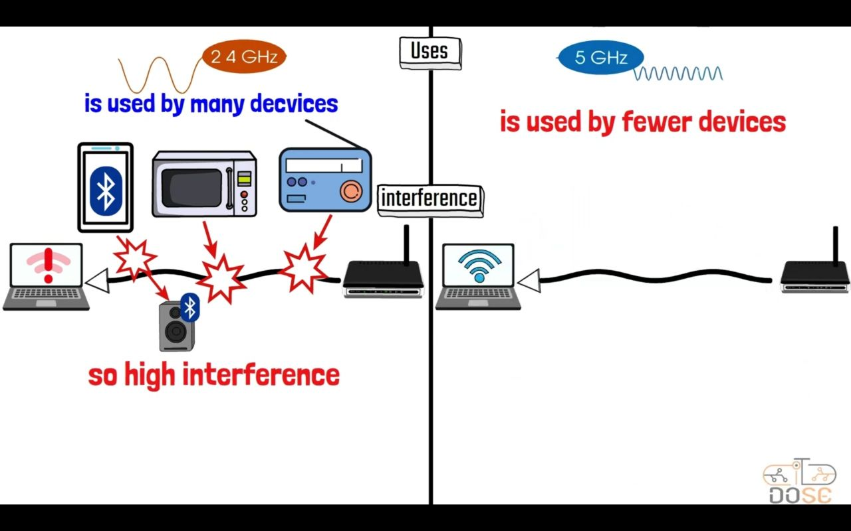
Wireless

Slide 50
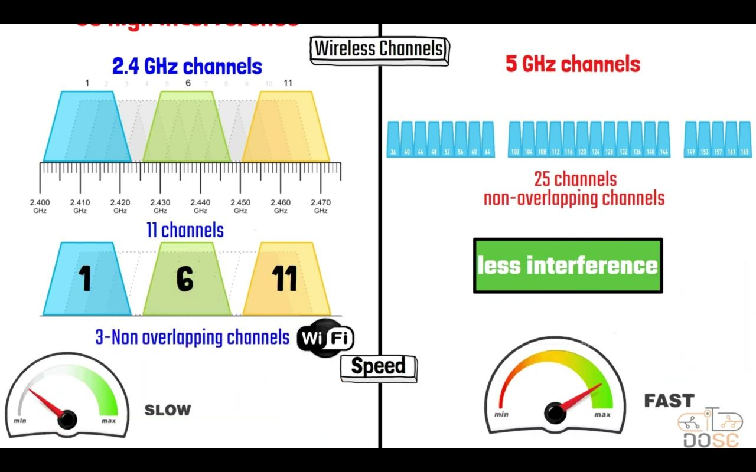
Wireless

Slide 51
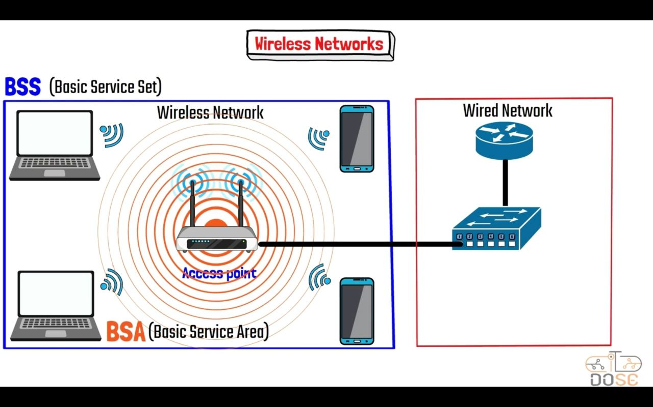
Wireless

Slide 52
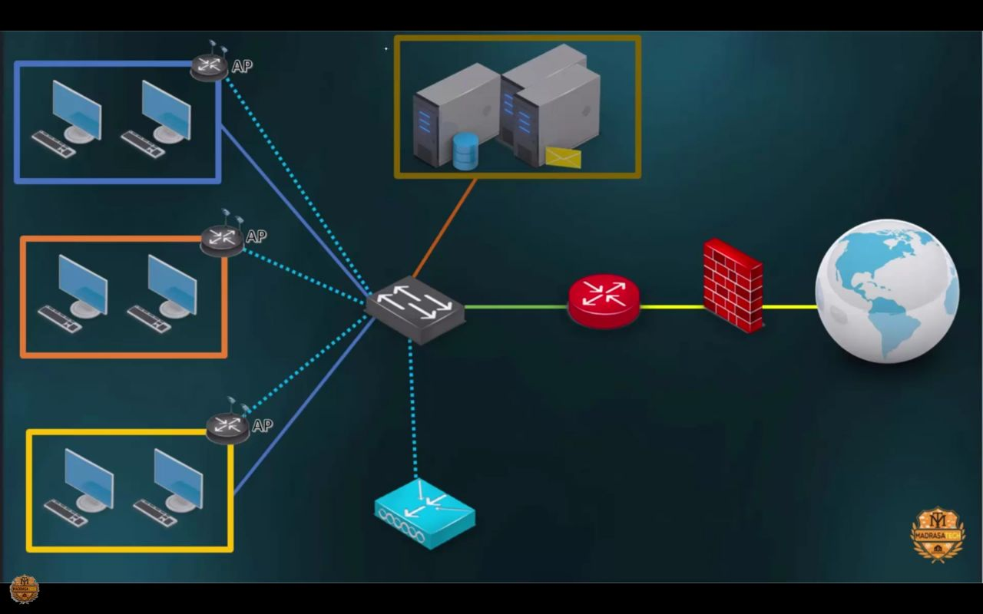
Wireless

Slide 53

Remote access
key Benefits of Remote Access:
Flexibility: Enables users to access network resources from anywhere, at any time, which is especially beneficial for remote learning and telecommuting.
Security: Ensures data is encrypted and secure during transmission over public networks, protecting sensitive information from interception.
Productivity: Allows users to work remotely without losing access to essential tools and resources, thereby maintaining productivity
Secure Shell (SSH):
Description: Provides a secure way to access and manage network devices and servers remotely via command-line interface.
Use Case: IT staff and researchers can remotely manage servers and network infrastructure securely, ensuring that administrative tasks can be performed from any location.

Slide 54

Remote access

Slide 55

Remote access

Slide 56


SERVERS
TFTP Server (Trivial File Transfer Protocol)
A TFTP server is a simple file transfer protocol server used for transferring files without requiring authentication or complex configurations. It uses UDP for communication and is often employed in scenarios where simplicity and speed are essential, such as booting devices over a network, network device configuration, and firmware updates.
FTP Server (File Transfer Protocol)
An FTP server is a server that uses the File Transfer Protocol to transfer files between a client and server over a network. It supports authentication (usually requiring a username and password) and can provide various levels of access control. FTP servers are widely used for uploading, downloading, and managing files on remote servers.

Slide 57


SERVERS
DNS Server (Domain Name System)
A DNS server translates human-readable domain names (like www.example.com) into IP addresses that computers use to identify each other on the network. This process, called domain name resolution, is essential for routing internet traffic and making it possible for users to access websites using easy-to-remember names instead of numerical IP addresses.
HTTPS Server (Hypertext Transfer Protocol Secure)
An HTTPS server is a web server that uses HTTPS to secure communication between the client (usually a web browser) and the server. HTTPS combines HTTP with SSL/TLS encryption to protect data transmitted over the internet, ensuring that sensitive information like login credentials, payment details, and personal data remains confidential and secure from eavesdropping or tampering.

Slide 58


IP
Subnetting
4 byte
1 byte
1 byte
1 byte
1 byte
What is Subnetting?
Subnetting is dividing a large network into smaller parts to make it more efficient and manageable
The 32 bit of ip divided into 3 classes
IP Address:
A unique number for each device on a network
“192.168.1.10”
Subnet Mask:
A number that shows which part of the IP address is the network and which part is for the host
“255.255.255.0”
Decimal
Binary
255.255.255.0 = 11111111.11111111.11111111.0

Slide 59

Subnetting
The num. of network (2^Y)
The num. of hosts(2^X)-2
CIDR
(classless inter-domain routing)
VLSM
)Variable length subnet mask(
It’s a number specific how much of the ip addresses used in the network
Subnet design that uses more than one mask in the network
To allows subnet masks to have variable size
Example ip
192.68.1.10/24 11111111.11111111.11111111.00000000
Network
Hosts

Slide 60

NAT
Nat protocol
Privet ip
Public ip
NAT
(Network address translation )
Every device have privet ip but to access the internet the device must have public ip
The public ip is paid ip
We have 3 types of NAT
Static NAT
dynamic NAT
PAT

Slide 61

NAT
One public ip for the network
PAT
Port address translation
Ports
unique number
0-65535

Slide 62


Security
ACL (Access Control List)
An Access Control List (ACL) is a set of rules used to control network traffic and reduce network attacks.
ACLs can permit or deny traffic based on various criteria such as IP address, protocol type, and port number. They are commonly used in routers and firewalls to filter inbound and outbound traffic and to enhance network security by controlling which devices or users can access specific resources.
Port Security
Port Security is a feature on network switches that allows you to control access to a switch port based on the MAC addresses of devices. By enabling port security, you can limit the number of devices that can connect to a port, and specify which MAC addresses are allowed to connect. This helps prevent unauthorized devices from accessing the network and can protect against MAC address flooding attacks.

Slide 63

Security
DHCP Snooping
DHCP Snooping is a security feature that acts as a firewall between untrusted hosts and trusted DHCP servers. It prevents malicious or rogue DHCP servers from providing false IP address configurations to clients.
DHCP Snooping works by monitoring DHCP messages and maintaining a database of trusted IP addresses and their corresponding MAC addresses. Only messages from trusted ports are allowed to pass through, while those from untrusted ports are filtered out. This helps ensure that clients receive accurate IP configurations and reduces the risk of attacks such as IP address spoofing.

